Slide 1
DATA SCIENCE CAREER TRACK
CAPSTONE 1
MILESTONE REPORT
by Edward Franke

Slide 2
AGENGA
Executive Summary
Idea Discussion
Findings
Conclusion
What’s Next

Slide 3
Executive Summary
The purpose for this project is to find a correlation connected to fraudulent credit card transactions that can separate them in real time compared to legitimate transactions. The dataset is a cleaned dataset from Kaggle.com. It has been discovered there is a correlation connected to fraudulent transactions, but the code required to separate it from the legitimate transactions has not yet occurred. The most promising results comes from pandas profiling function which gives the following data:

Slide 4
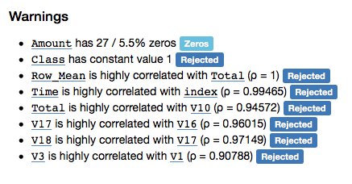
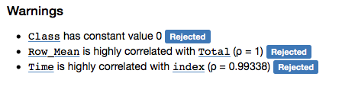
Fraudulent Transactions
Legitimate Transactions

Slide 5
Idea
IDEA: A model to detect fraud in credit card transactions. (problem to solve)
CLIENT: Credit Card Companies
REASON: If they don’t detect and stop the fraud as it happens, their customer don’t pay the cost, they do. This project is intended to reduce their expenses and increase their profits.
DATA: From Kaggle, a cleaned dataset with 284,807 transactions from 2013 with 492 frauds in total.
SOLUTION: Create a model or analysis to discover what makes fraudulent transaction similar to detect this relationship as it happens.
DETAILS: See Detail Section Below.
DELIVERABLES: Working code that detect fraud as it receives data and a presentation outlining the discoveries and explain the methods used to reach the discoveries.

Slide 6

Findings
This is the code that was used to separate the initial dataframe into separate dataframes only containing fraud or legit transactions.
While comparing the transactions, I noticed fraudulent transactions have a greater histogram area that legitimate transactions. I was under the impression that I could create code to determine any transaction with a total V set as below -17 as fraudulent. However, as this overlayed histogram comparison shows, that would fail the purpose of the project. A solution is still being sought.

Slide 7
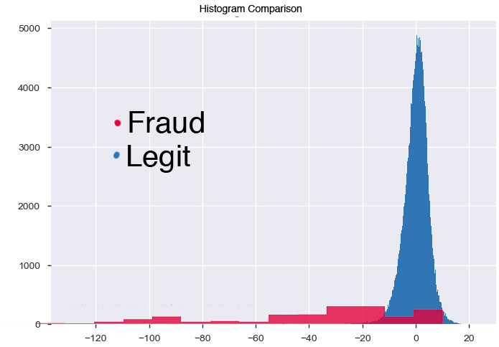
Conclusion

Slide 8
What’s Next
Deep Dive
Discover what connects fraud transactions (V1 and V3, V16 and V17 and V18)
Write code that detects this correlation as the transactions come in
Run Statistical Analysis to determine error levels
Final Report and Presentation

